Slide 1
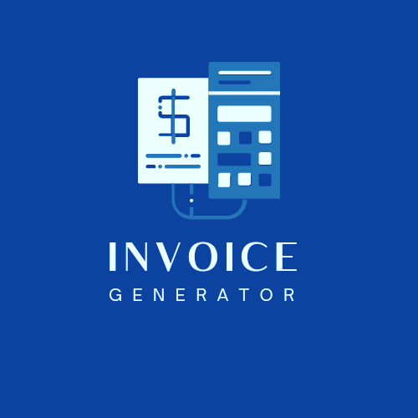
Invoice Generator
PR-08 Advanced Java and Network Programming (Minor Project)

Slide 2
AGENDA
Introduction
Primary Goals
Requirements
​Modules
Data Flow Diagram
​Snippets of modules

Slide 3
Introduction
An Invoice is a commercial document issued by a seller to a buyer indicating the product’s quantities and monetary terms.

Slide 4
PRIMARY GOALS
To generate bill for customer.
Maintain the product’s details in a database.

Slide 5
Requirements
Software Requirements:-
Front End : NETBEANS16.
Back End : MySQL Server.

Slide 6
modules
Login window
Home window
Edit items window
Generate invoice

Slide 7
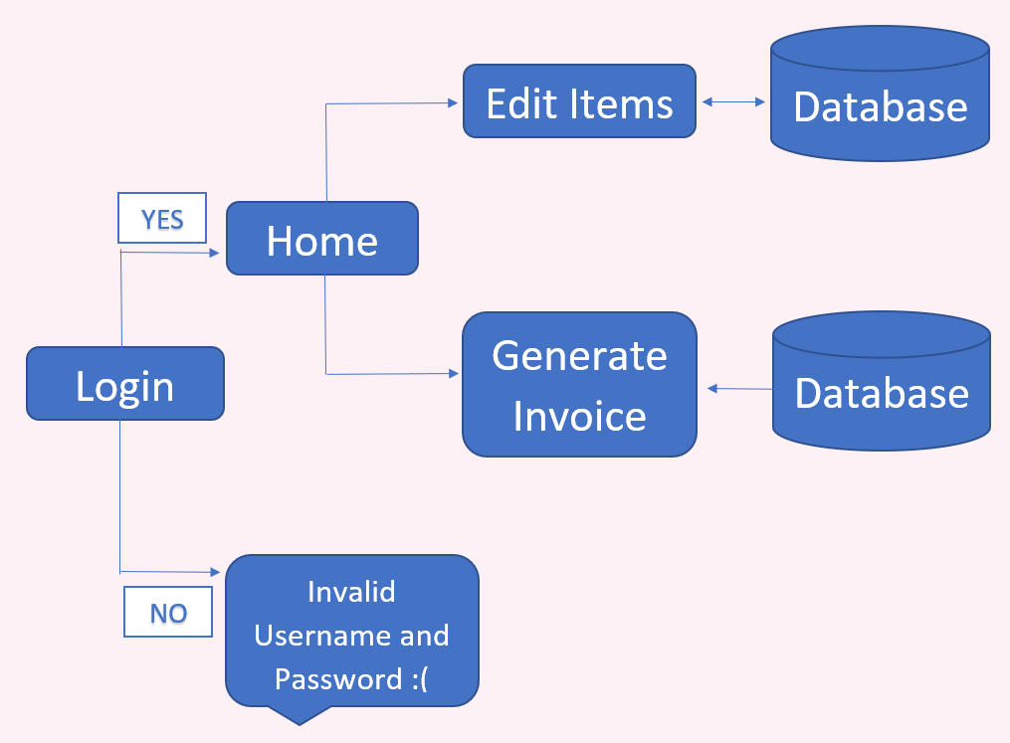
Data flow diagram (dfd)

Slide 8
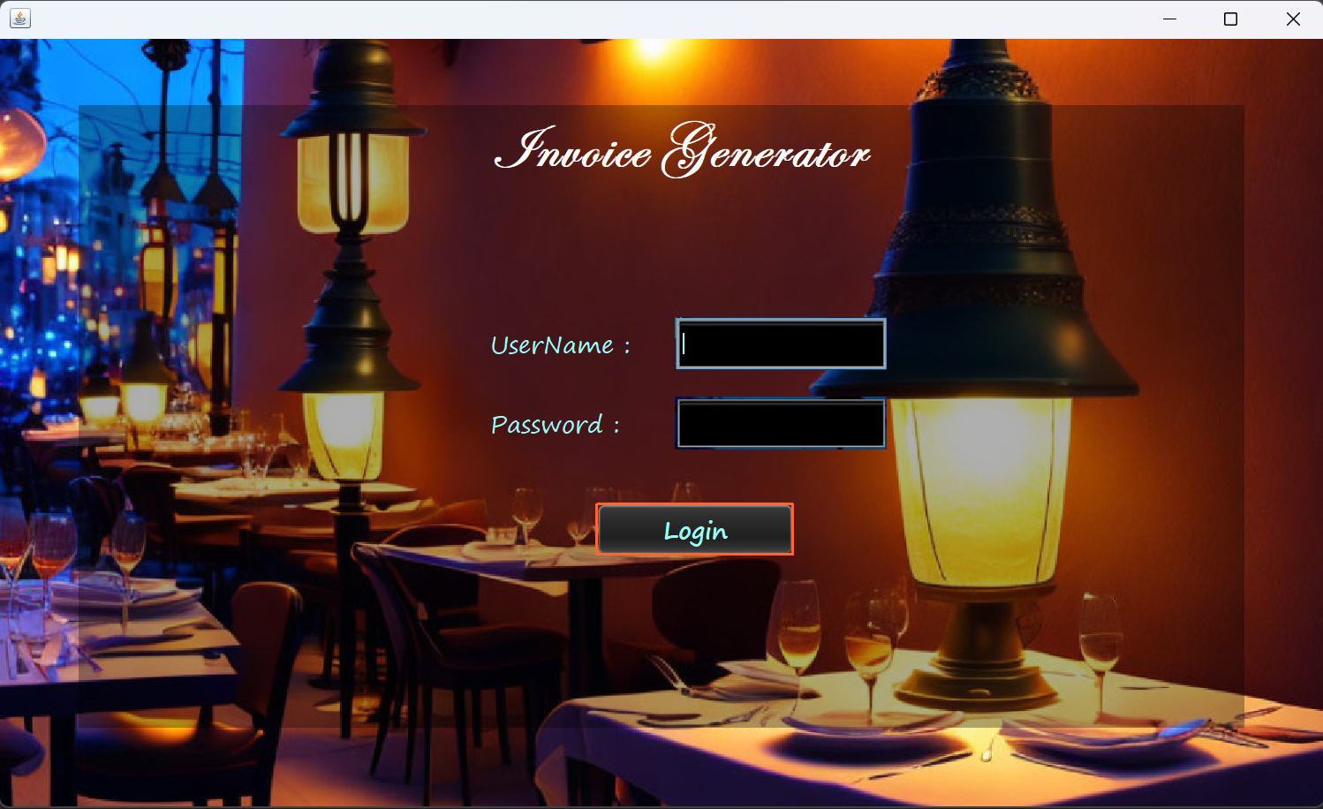
LOGIN WINDOW

Slide 9
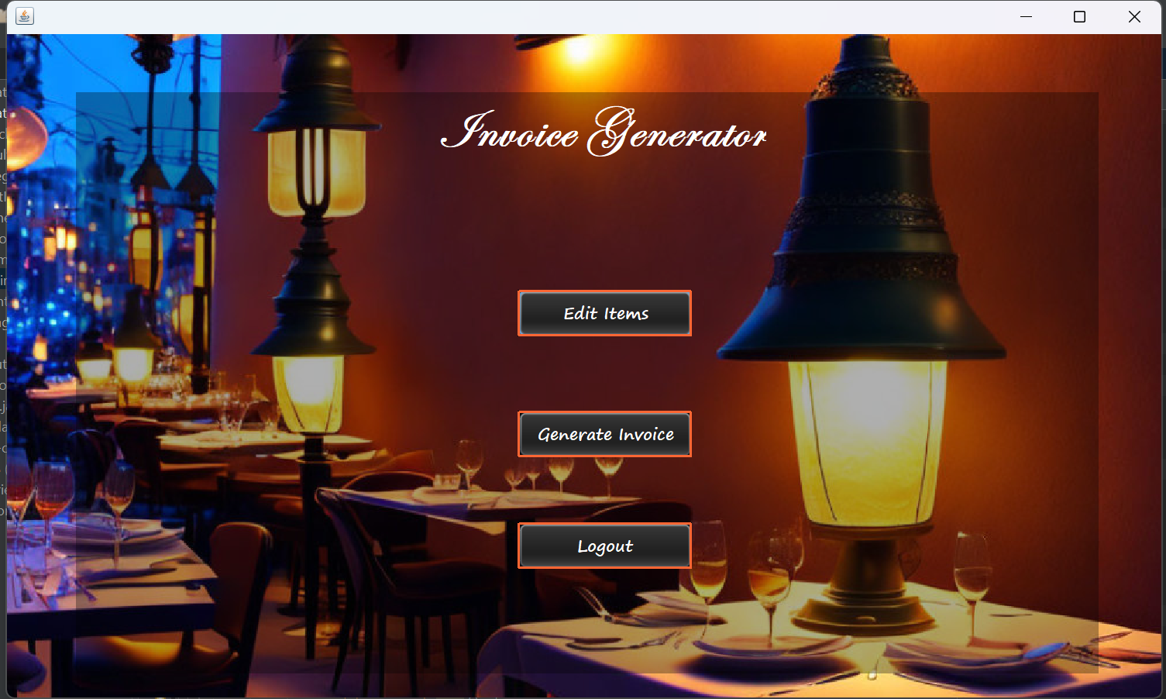
HOME WINDOW

Slide 10
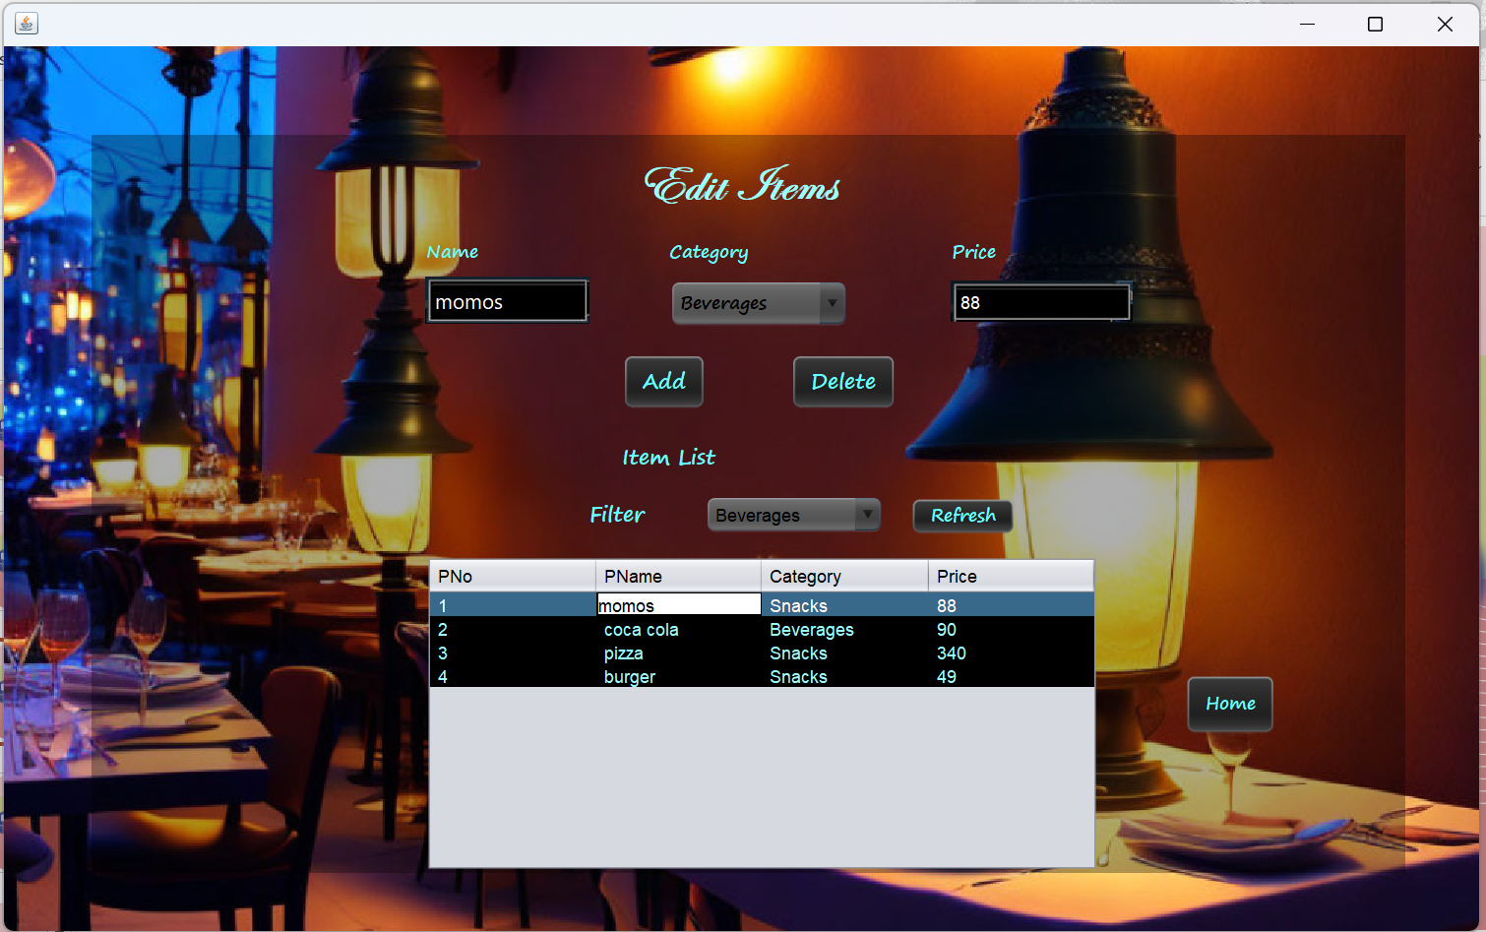
EDIT ITEMS WINDOW

Slide 11
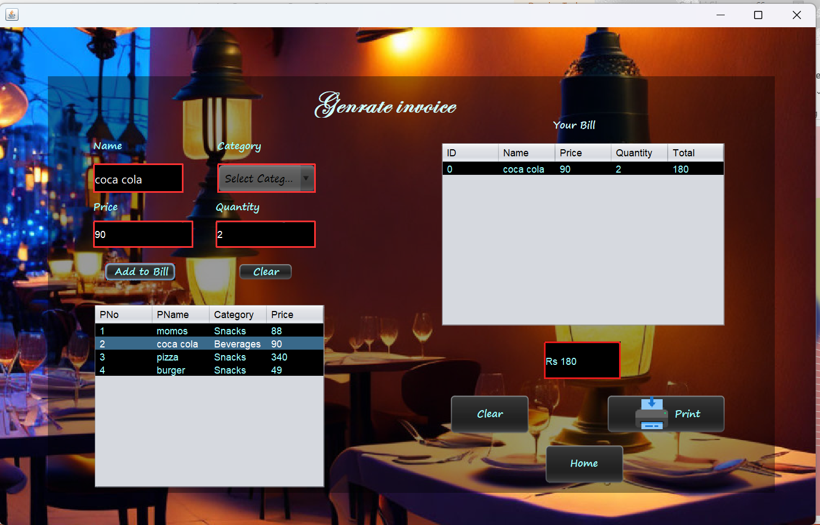
GENERATE INVOICE WINDOW

Slide 12
THANK YOU
PRIYANKA SAKSHI SHARMA

